Slide 1
NY AirBnB

Slide 2
Agenda
Objectives
Background
Data Analysis
Key Findings
Recommendations
Appendix

Slide 3
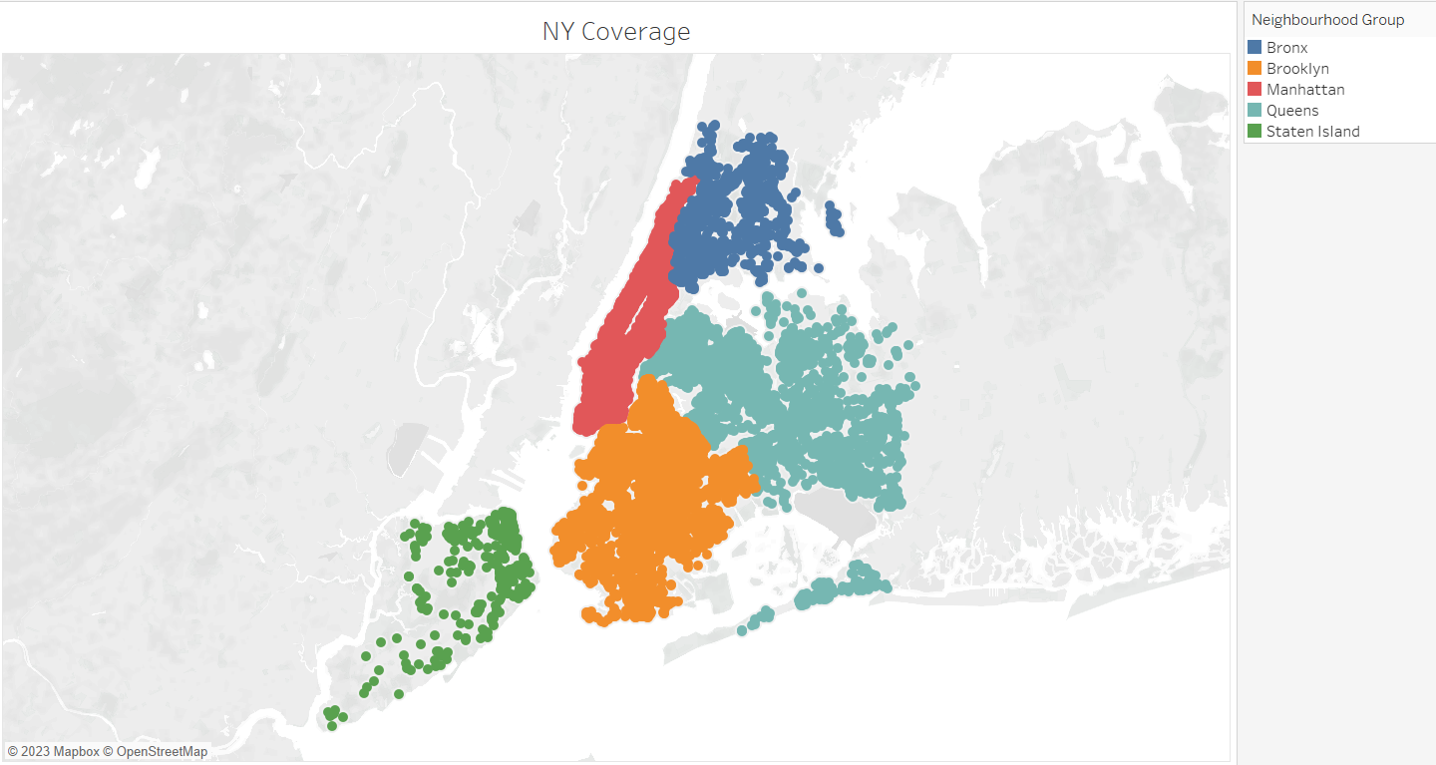
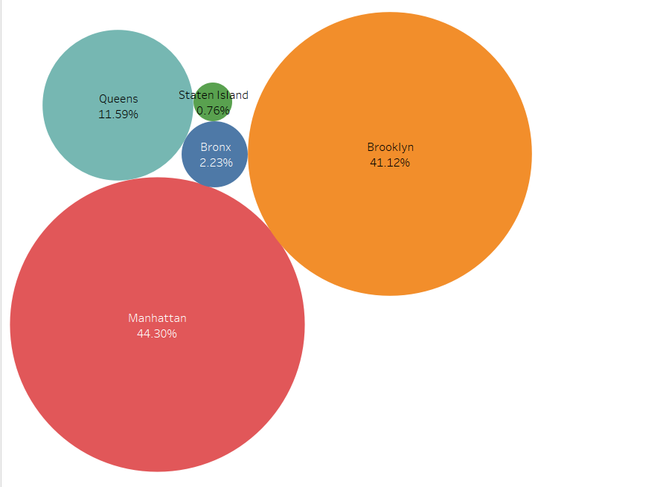
Background
For the past few months, Airbnb has seen a major decline in revenue. Now that the restrictions have started lifting and people have started to travel more, Airbnb wants to make sure that it is fully prepared for this change.
AirBnB have shared data for NY regions including Manhattan , Brooklyn , Queens , State Island and Bronx for analysis to decide an approach to increase the revenues.

Slide 4
Data Analysis
48895 listings were available in data from 5 neighbourhoods groups consisting of 221 neighbourhoods
Details available such as neighbourhood , neighbourhood group, longitude latitude ,room type , prices, minimum nights , number of reviews , number of reviews per month, calculated host listing count and availability 365.
For measures there were outliers. As all outliers can be completely valid and useful. We have kept it as it is and wherever required binning is used to group the data. Also , instead of mean / average , median is used in analysis for rest of the fields.
Price : Based on quantiles and outliers , bins are created.
Minimum nights : Based on quantiles , bins are created.
Reviews/ Reviews per month : Medians are used in analysis.
Calculated host listing and availability 365 : We used them as dimensions for better analysis.

Slide 5
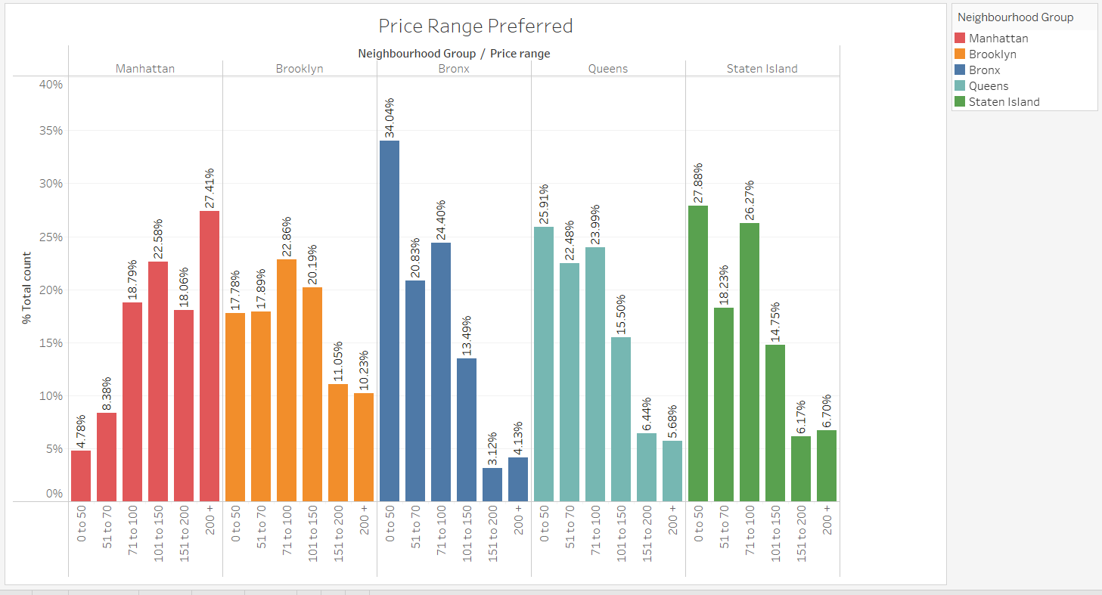
Prices Ranges

Slide 6
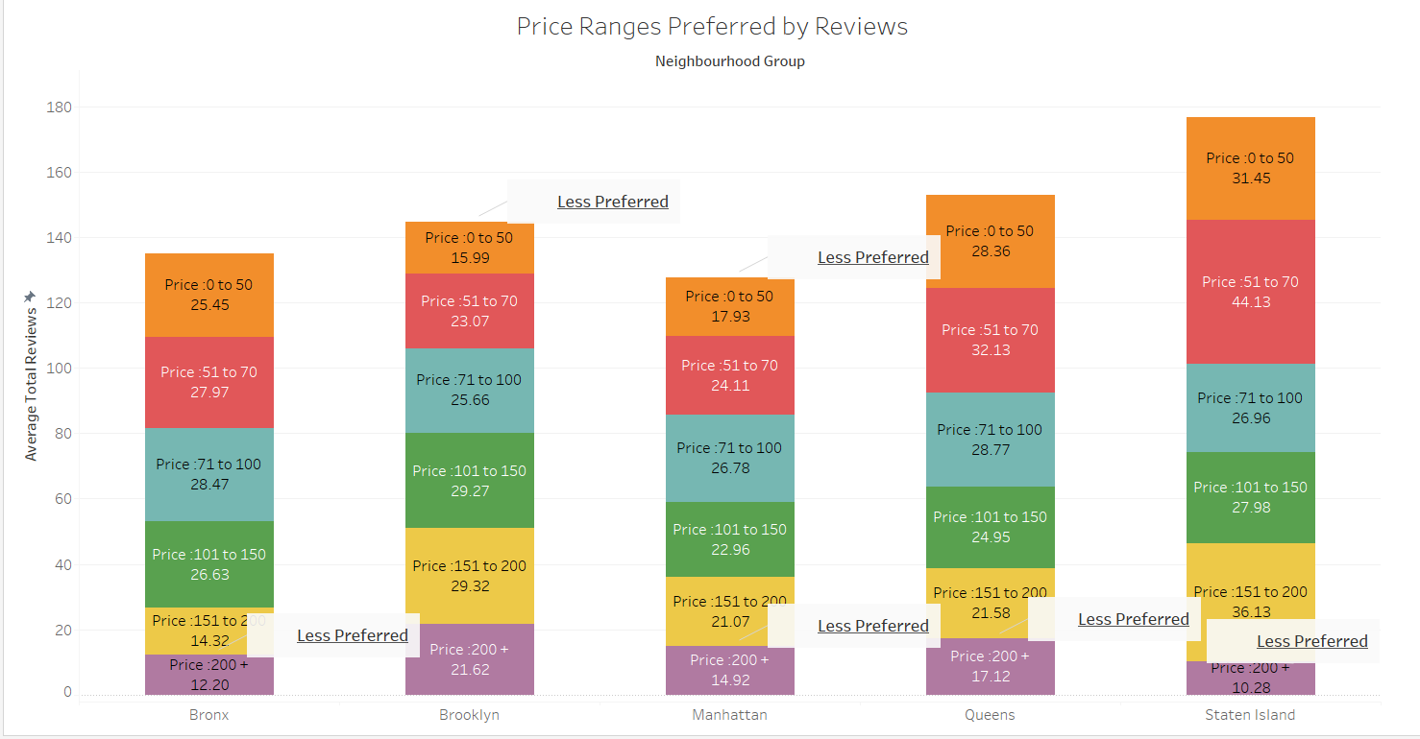
Price Ranges- Cont.

Slide 7
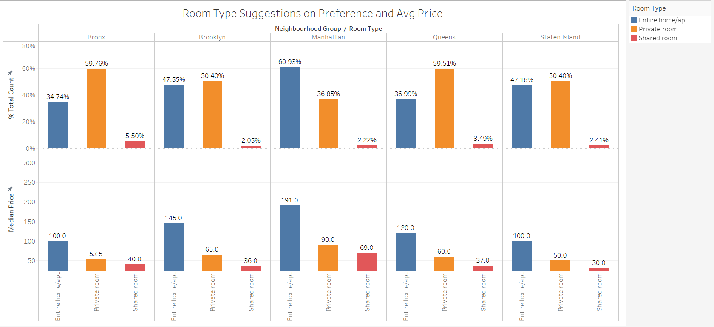
Price Ranges – cont.

Slide 8
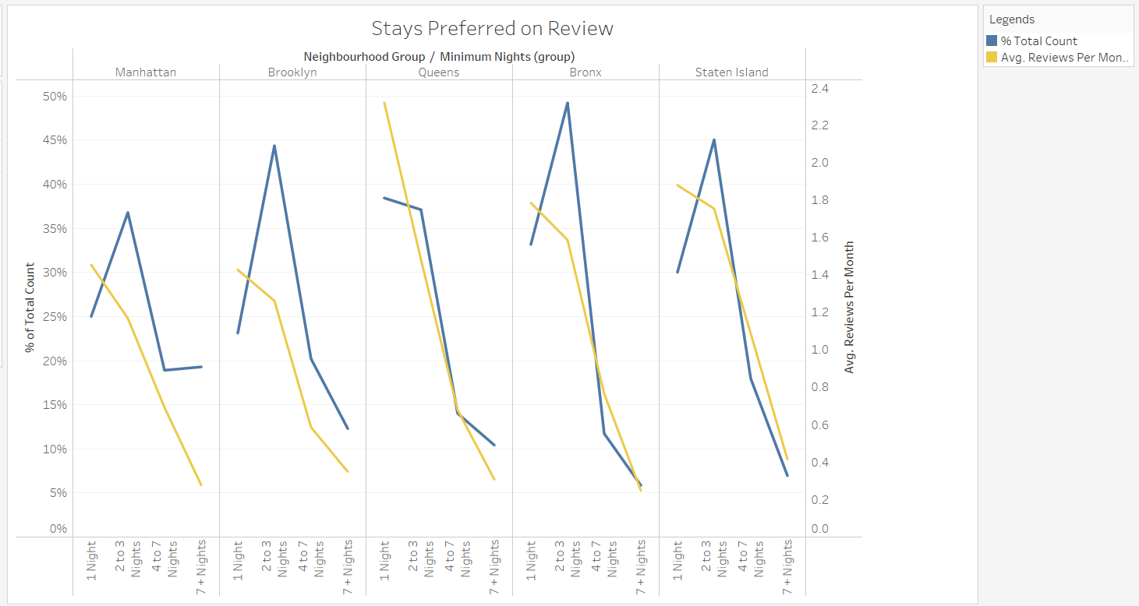
Customer Preferences – Minimum nights

Slide 9
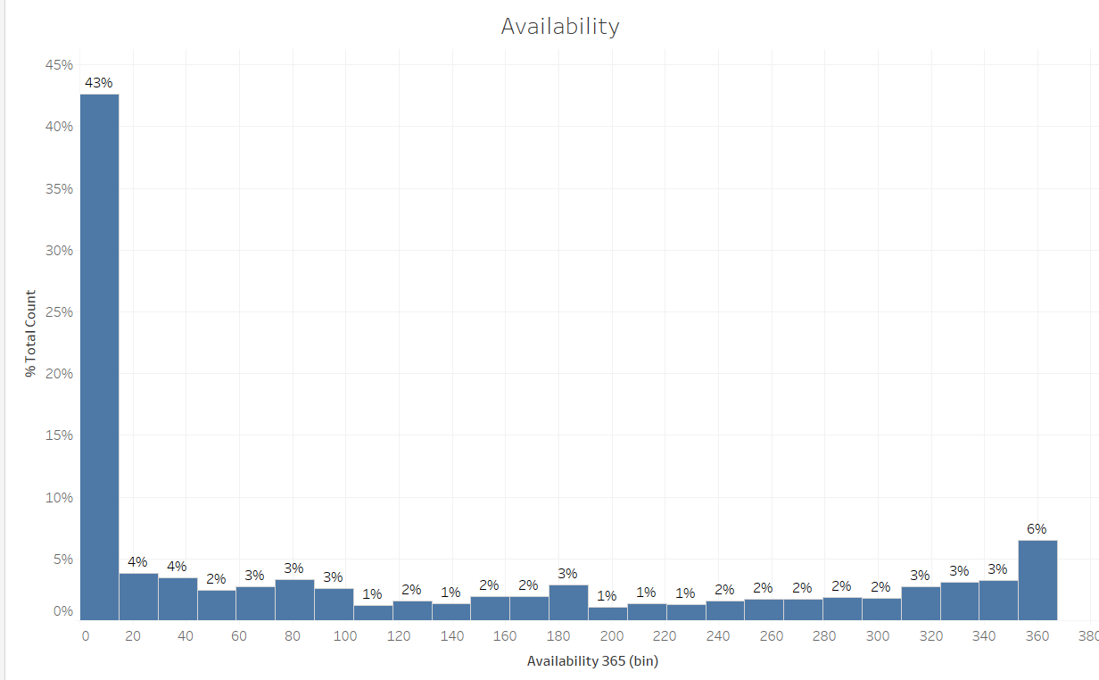
365 Availability

Slide 10
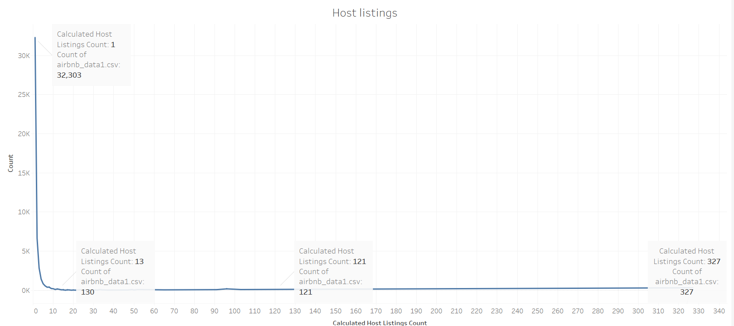
Host Listings

Slide 11
Recommendations
To increase the revenue , we need to start with reopening the existing properties or onboarding new properties . Following are the recommendations for the considerations.
We will need to get more details like number of rooms , number of min and max guests , facilities provided for better analysis and better pricing negotiations with hosts and guests.
Hosts having multiple listings or premium properties needs to be flagged for better segregation and analysis.
Along with number of reviews , team should capture ratings for the listings. That will help to improve the customer experience.
Other than above data related recommendations , following are other actionable items :
More than 40% properties are not opened yet , also the ones which are opened , many of them are not available for even half of the year. So contact these hosts to encourage reopening of these properties and make them available for as many days as possible.
Focus on Manhattan and Brooklyn for reopening existing properties as they cover 85% of business. Also, State Island is a small location but has more number of reviews. That means , customer noticing it more. So this region can also be considered for reopening existing properties and would be a great choice for onboarding new properties.
For Manhattan and Brooklyn , focus on middle range properties i.e. between $51 to $200. For rest of the regions , all except high rent properties (rent > $200) can be looked into.
Focus on hosts hosting either entire apartment or private rooms. Shared rooms are less and due to recent Covid situations people will not prefer them. We can also try to convince the hosts to convert them to private rooms.
Hosts need to be convinced reduce the minimum nights to maximum 3 as beyond that customers may not prefer.
Host connects can be prioritized based on number of listings as many hosts are handling more than 100 properties.
For all of the above , AirBnB can work with hosts to give good deals to hosts and customers both.

Slide 12
Appendix - 1
https://github.com/PrajsPrabs/upGrad_Airbnb/blob/main/AirBnB_Methodology.docx

Slide 13
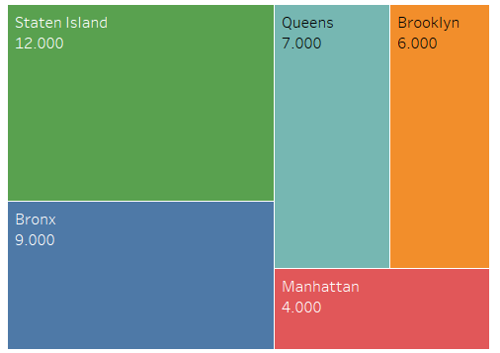
Appendix – 2

Slide 14
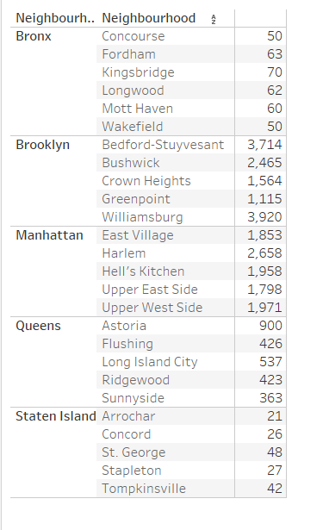
Appendix- 3
Top 5 locations in each neighbourhood

